Slide 1
ASL-Retranslation: Bridging Communication with a Robotic Hand
By:
Anirudh Jayan - CB.SC.U4AIE24007
Abhinav Variyath - CB.SC.U4AIE24002
Sarvesh Ram Kumar - CB.SC.U4AIE24048
Tara Samiksha - CB.SC.U4AIE24045
Aravind S Harilal- CB.SC.U4AIE24008

Slide 2
Project Overview
Our project aims to create a robotic hand made out of wood, that can dynamically represent ASL gestures based on text input. This will facilitate communication for individuals who use ASL. We also aim to create an intuitive and easy to use UI, which will help users visualize finger movement, and also proviede them an easy way to control the hand.
Key Goals:
Accurate ASL letter representation.
Simplified sentence processing for efficient translation.
Modular design for adaptable construction
Use of readily available components (Arduino, PCA9685, servo motors).
Easy to use website to control the robotic hand (Using HTML, CSS and JavaScript).
Efficient connection between Frontend website, Python, and to Arduino

Slide 3
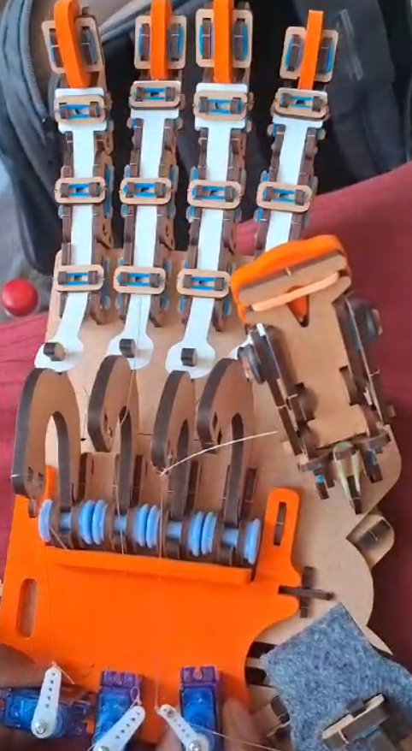
Materials Used
Hand Structure: Wood model
Actuation:
5V, 2A AC to DC adaptor
PCA9685 (to connect 6 servos)
6 Servo Motors (for finger movement)
Fishing Wire (to transmit force to fingers)
Elastic Bands (for finger retraction)
Foam (for placing servos)
Control System: Arduino microcontroller

Slide 4
Technical Implementation: Hardware
The system uses an Arduino board to control multiple servo motors. Each servo corresponds to a finger or wrist joint. Fishing wire connects the servos to the finger joints, allowing for extension. Elastic bands provide the opposing force, pulling the fingers back to a resting position when the servo is not actively pulling.
Arduino: The central microcontroller, processing input and sending control signals to the servos.
PCA9685: Used to connect upto 16 servo motors using external power supply.
Servo Motors: Provide precise angular control for finger positioning.
Wiring: Connects the Arduino to the servo motors, power supply, and any input devices.

Slide 5
PCA9685: 16-Channel PWM Driver
I²C-bus controlled 16-channel PWM driver.
Designed for LED control but widely used for servo motor applications.
12-bit resolution (4096 steps) per channel for precise control.
PWM frequency: Adjustable from 24 Hz to 1526 Hz.
Duty cycle range: 0% to 100%.
Can control multiple devices using a single I²C bus.
Each servo operates with a specific PWM signal (typically 50 Hz frequency).
Duty cycle variation determines servo angle:
1 ms → 0°
1.5 ms → 90°
2 ms → 180°

Slide 6
Servo Motor Specifications
The actuation of the robotic hand relies on precise and reliable servo motors. We selected SG90 servos based on our needs:
Parameter | Specification
Operating Voltage | 4.8V ~ 6.0V
Stall Torque | 2.0 kg/cm (at 4.8V) 2.2 kg/cm (at 6.0V)
Operating Speed | 0.09 sec/60° (at 4.8V) 0.08 sec/60° (at 6.0V)
Rotation Angle | 180° (Maximum)
Dead Band Width | 7 µs (microseconds)

Slide 7
Technical Implementation: Software
The software implementation involves Python for preprocessing and the Arduino IDE for controlling servo motors. Python processes input data and sends commands to the Arduino, which then controls the servos based on received instructions.
Python for Preprocessing: Handles text-based input and converts it into servo commands.
spaCy: An NLP-based library used for text preprocessing.
Serial: A library for sending information via a serial connection, enabling communication with the Arduino IDE for servo control.
Arduino IDE: Used to send instructions to the Arduino, which then controls the servo motors.
Servo Control Logic: The Arduino receives letters from Python and maps them to specific servo angles, allowing precise hand movement.

Slide 8
Technical Implementation: Speech-to-Text (via Gemini)
This component focuses on converting spoken language into text using browser technologies and Google's Gemini API. This transcribed text then serves as the input for the ASL translation/animation stage.
Web Audio API: uSED directly within the browser (using JavaScript) to request microphone access and record audio from the user. Captures audio in a suitable format.
JavaScript: Manages the recorded audio data as a `Blob` object. Controls the entire process, making asynchronous network requests (`fetch`) to external APIs.
Google Gemini API: Once uploaded, the audio file's URI is sent to the Gemini `generateContent` API endpoint. A system instruction prompts the model to perform only voice-to-text transcription, returning the spoken words as plain text.
DOM Manipulation & Integration: JavaScript updates the user interface to show recording status, provides audio playback controls, displays the final transcription, automatically populates the text input field and triggers the form submission.

Slide 9
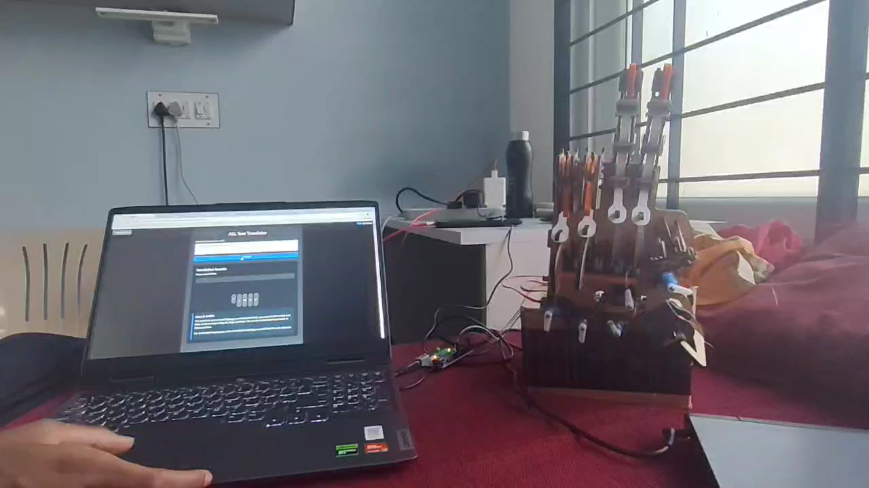
Execution

Slide 10
Future Work & Enhancements
Expanded Vocabulary: Increase the number of ASL signs supported, including more complex gestures and potentially dynamic movements.
Improved Dexterity: Explore more advanced hand designs with more degrees of freedom (e.g., individual finger joint control).
Real-time Translation: Integrate with faster and local speech recognition software to enable real-time speech-to-ASL translation.

Slide 11
Conclusion
ASL-Retranslation offers a promising approach to making ASL more accessible through technology. By combining readily available hardware with clever software, this project demonstrates the potential for creating assistive devices that can bridge communication gaps. While there are challenges to overcome, the project's modular design and focus on core functionality provide a solid foundation for future development.

